Slide 1
Task Manager
Akshay Sapra, Enrique Calderon, Akshat Sharma

Slide 2
Program
Programmed the application using Java Swing on NetBeans IDE
Dropbox and google libraries used for some applications

Slide 3
How we tackled it
Started off by designing some basic user interfaces on paper
Then implemented some basic UI’s on NetBeans
Slowly added on features and increased functionality of the application
Improved design for better user-interaction
Added Cloud and google support to the application

Slide 4
Features
Add, edit and delete notes.
Upload notes onto Dropbox
Keep track of your progress
Add/Edit contacts
Add events and To-Do lists
Have a google search bar at all times

Slide 5
To-do List
Implemented using individual checkboxes
Would have been better if I got an arrayList of checkboxes
Couldn’t figure out how to do an arrayList of checkboxes

Slide 6
Dropbox integration
Gives user ease of uploading and sharing their notes
Simply click on button, and it uploads to dropbox (assuming you have the access token for signing up)

Slide 7
Features Note taking
Note taking options where the user is able to take notes
You can edit the notes taken in the note editor
You can delete the notes that you don't need
You can save files into dropbox

Slide 8
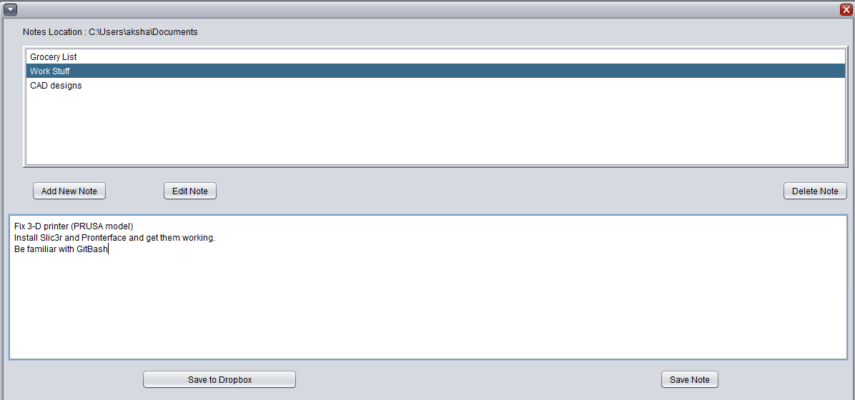

Slide 9
Google search bar
Searches google for the query suggested, with the default browser
Gives user the convenience of searching for random things that pop up in their mind

Slide 10
Features Calendar
The calendar has the option to look any day that you want
You can add future task that you need to complete
You have a way to add contacts
The to do list and contacts are saved and will be there even if you close the program

Slide 11
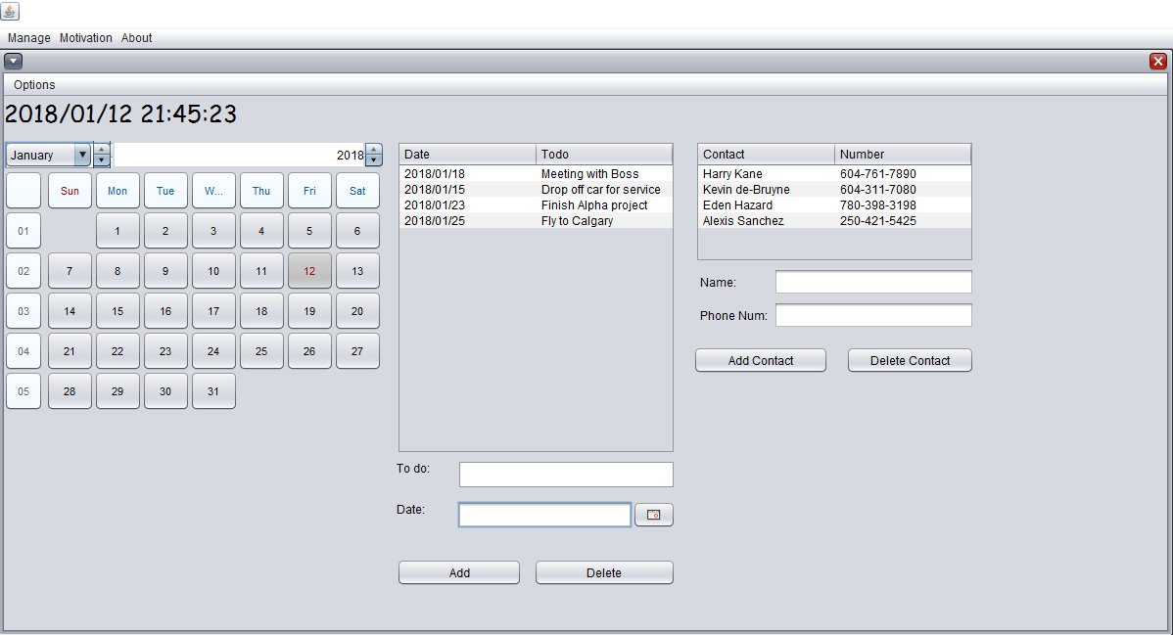

Slide 12
Features Motivational bar
Everyone needs a bit of joy in their lives
We created a bar where the user can get their dose of fun even if they had a long day
We linked it to youtube, reddit and a cat video site

Slide 13
Known problems
“Delete Note” button gives an unessential pop-up (minor bug)
Dropbox integration worked correctly with a text file created by the program, but failed to correctly identify the note file created by the user - we fixed this later in the evening

Slide 14
Future improvements
Fix all known bugs
Improve layout (Add more life to our project)
Add more features ( Sync notes from Google , Facebook events, chat rooms, games )
Make it accessible to other users who don't speak English
Improve UI/UX

Slide 15
Conclusion
A great task manager that we would probably use after some additions and modifications
The team did good and we are proud to be presenting this work

